Slide 1
Physical Activity
Notes:
2
Physical Activity impacts health, wellness and fitness.
The rest of the presentation will cover specific information about fitness.

Slide 2
Physical Activity
The term “physical activity” describes many forms of movement, including activities that involve the large skeletal muscles.
Activities that involve the small skeletal muscles (e.g. playing board games, drawing, writing) are important, but they do not provide the health benefits of activities that involve the large skeletal muscles and require substantial energy expenditure.

Slide 3
1. Physical activity is a priority lifestyle that impacts health, wellness, and fitness.
2. Body movement carried out by skeletal muscles that requires energy
3. Physical activity essential to health, but exercise necessary to improve fitness
4. Increasing physical activity to improve health and wellness
5. People can obtain greater health and wellness benefits by increasing the duration and intensity of physical activity

Slide 4
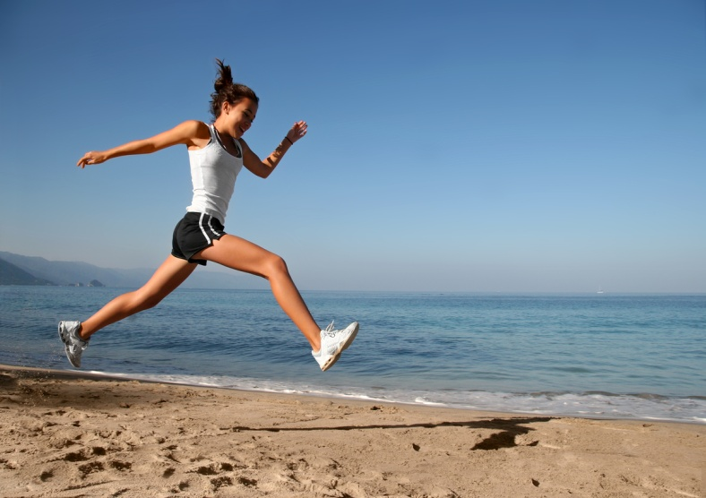
Physical activity is defined by its duration, intensity, and frequency
Duration is the amount of time spent participating in a physical activity session
Intensity is the rate of energy expenditure
Frequency is the number of physical activity sessions during a specific time period (e.g. one week).

Slide 5
Types of Physical Activity
Aerobic - light to vigorous-intensity physical activity that requires more oxygen than sedentary behavior and thus promotes cardiovascular fitness and other health benefits (e.g., jumping rope, biking, swimming, running; playing soccer, basketball, or volleyball).
Anaerobic – intense physical activity that is short in duration and requires a breakdown of energy sources in the absence of sufficient oxygen. Energy sources are replenished as an individual recovers from the activity. Anaerobic activity (e.g., sprinting during running, swimming, or biking) requires maximal performance during the brief period.

Slide 6
Lifestyle – physical activity typically performed on a routine basis (e.g., walking, climbing stairs, mowing or raking the yard), which is usually light to moderate in intensity. Physical activity play – play activity that requires substantial energy expenditure (e.g., playing tag, jumping rope). Play – activity with flexible rules, usually self-selected, for the purpose of having fun. Sports – physical activity that involves competition, scorekeeping, rules, and an outcome that cannot be predetermined. There are two categories of sports: individual and team. Weight-bearing – physical activity that requires people to move their own weight.

Slide 7
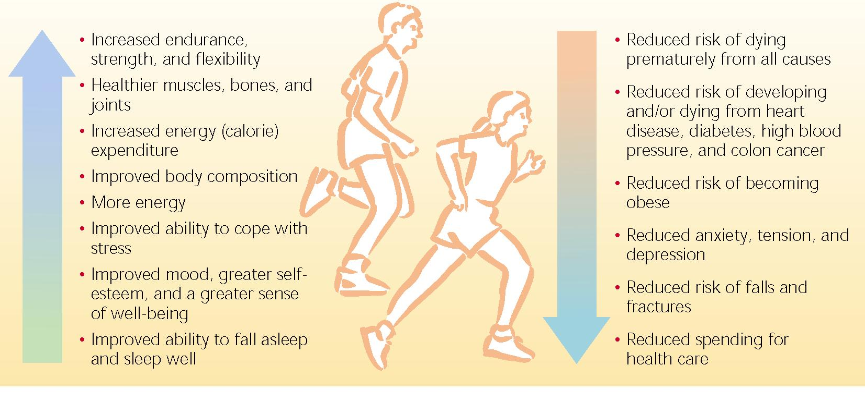
Benefits of Physical Activity

Slide 8
HEALTH BENEFITS
People who are usually inactive can improve their health and wellness by becoming even moderately active on a regular basis
Physical activity need not be strenuous to achieve health benefits
Greater health benefits can be achieved by increasing the amount of physical activity

Slide 9
To produce health benefits, the intensity, duration, and frequency of activity is less than that required to produce improved fitness.
Improved fitness is measured by how much exercise you can do. Improved health is measured by improved physiologic function of body systems.

